Slide 1
CSE110
Programming Language I

Slide 2
My Brief Profile
Nahian Salsabil (NNS)
Lecturer, CSE, BRACU
BSc: CSE, BUET, 2023
Email: Email: nahian.salsabil@bracu.ac.bd
Room No. UB80601
Consultation Hour:
Sunday: 11:00am - 1:30pm
Monday: 9:30am - 10:50am, 12:30pm - 1:30pm
Wednesday: 9:30am - 10:50am

Slide 3
Links
Resources: http://tiny.cc/cse110_resources_NNS
Slack: http://tiny.cc/cse110_slack

Slide 4
Outline
String

Slide 5
Strings
String is a sequence of ordered characters represented with quotation marks (single('), double(''), triple(' ' ' or '' '' '')) at the beginning and end.
A character can be lower case (a-z) or upper case (A-Z) alphabet, digits (0-9) or special symbols (+, -, #, %, * etc.).
The character order is always from left to right.

Slide 6
Strings: Example
'CSE 110' (using single quotes)
''CSE 110'' (using double quotes)
' ' 'CSE 110' ' ' (using triple single quotes)
'' '' ''CSE 110'' '' '' (using triple double quote)
All of these four String data are exactly same to Python.
The quotes at the beginning and in the end are not part of the String.
CSE 110

Slide 7
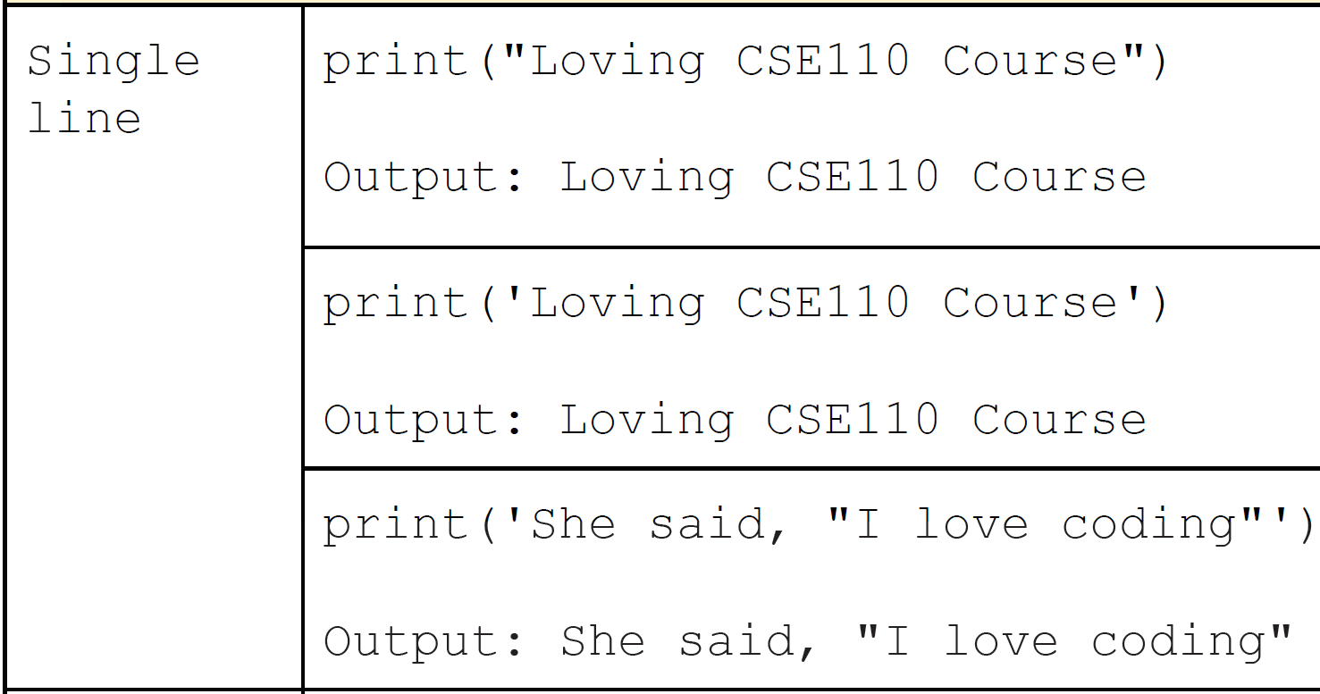
Single Line Strings

Slide 8
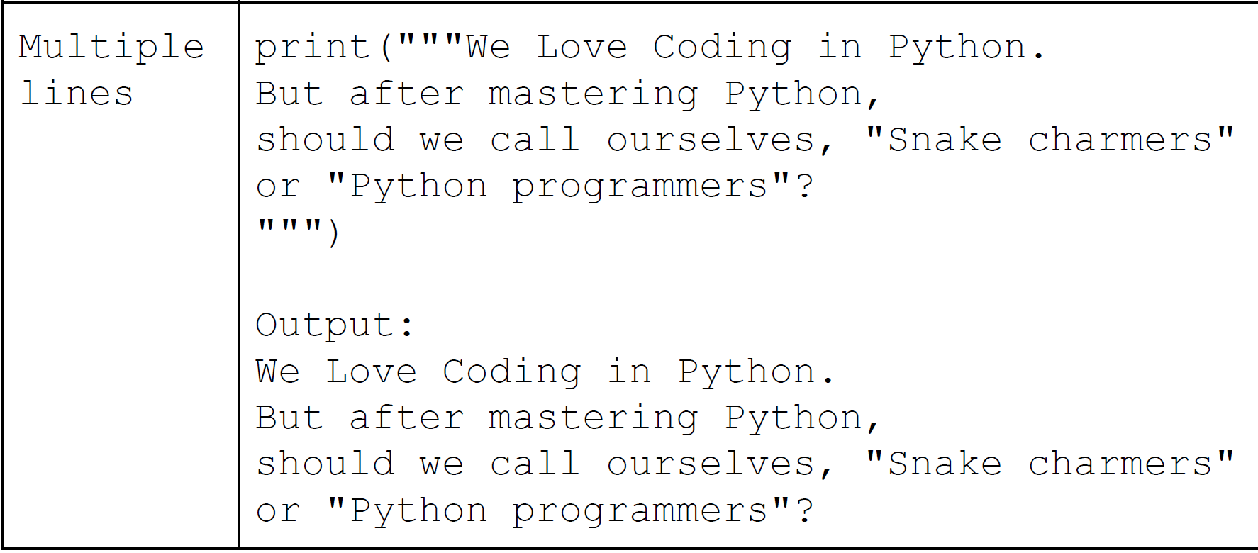
Multi-line Strings

Slide 9
Including quotes in Strings
Python understands the contents of a String using the quotes (single, double or triple) at the beginning and in the end.
Remember that these quotes are not part of the String.
So what if we want to include these quotes as part of the String?
Solution:
Use alternative quotes:
Enclose the strings in double quotes if you have to include single quote
Use escape character or backslash (\)
Precede the quotes with a backslash (\) to tell Python to treat the quotes as part of the String.

Slide 10
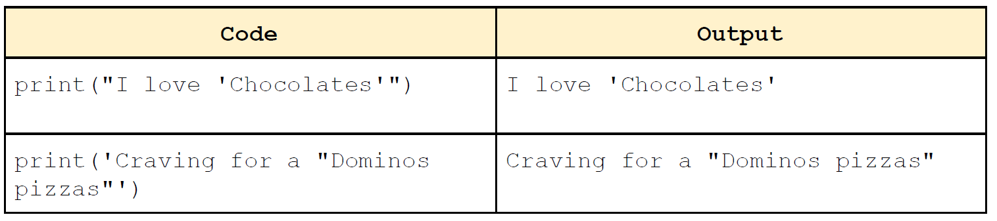
Using Alternative Quotes

Slide 11
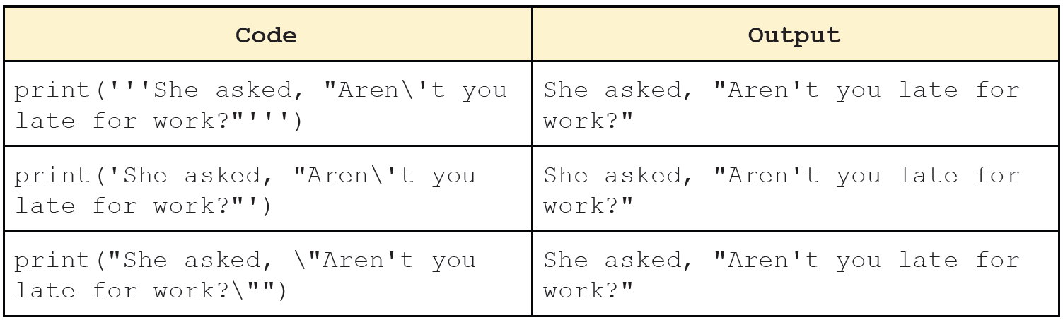
Using escape characters or backslash (\)

Slide 12
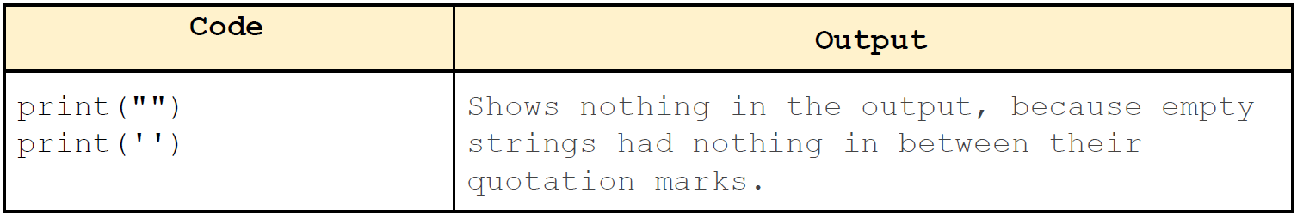
Empty String
Strings represented with only two single( '' ) or two double( "" ) quotes with no characters in between are called Empty String.

Slide 13
Accessing the Characters in a String
What if we want to access the individual characters of a String?
Previously, we saw that it can be accomplished using a for loop.
But using a for loop requires us to traverse the entire String.
But what if we want to access only the specific portions of the String?
Output:
C
S
E
1
1
0
for c in ‘CSE110’:
print(c)

Slide 14
String Indexing
Index indicates the position of a character in a String.
Indexing can be done in two ways:
Positive indexing:
Access the characters from the left side of a string.
Positive indexing always starts from 0 ( left-most character of the string ) and ends at the last character of the string.
Negative indexing:
Access the characters from the right side of a string.
Negative indexing always starts from -1 ( rightmost character of the string ) and ends at the first character of the string.
Indices are always integers.

Slide 15
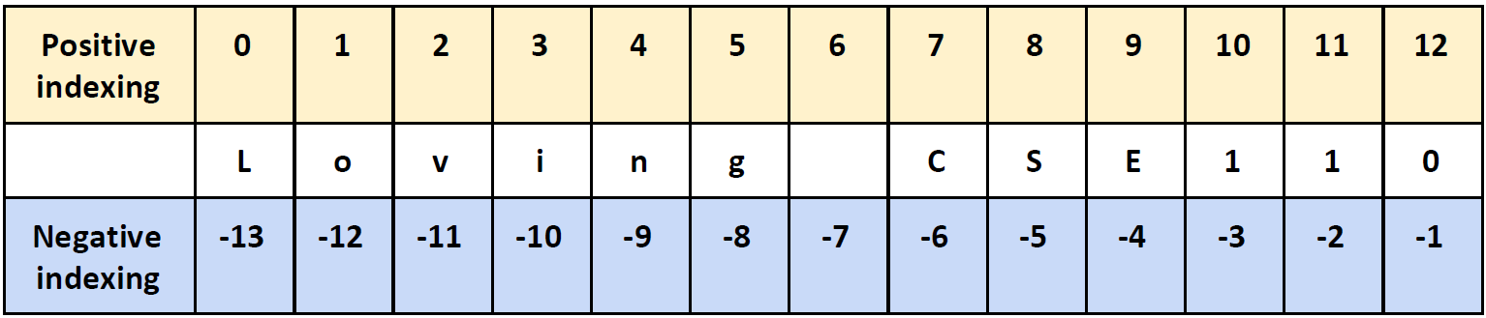
String Indexing
0
12
Loving CSE110
-13
-1

Slide 16
String Indexing
To access the character at a specific index or position, we need to do the following:
If anything out of the valid range is tried to be accessed, the program will yield an IndexError.
If any other data type except an integer is entered as an index, TypeError will rise.
name_of_string[ index ]

Slide 17
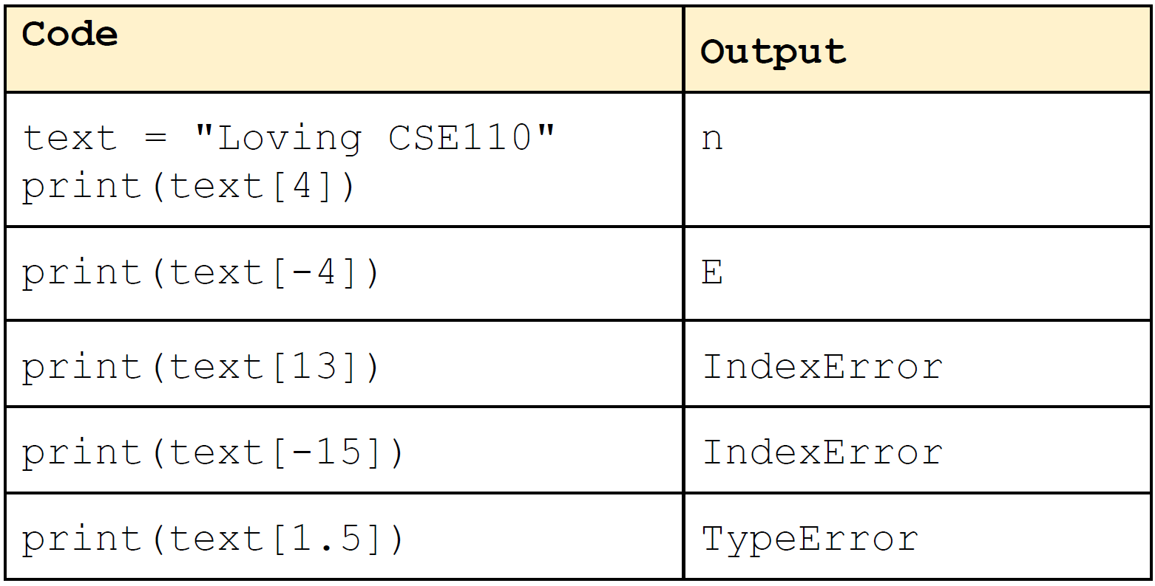
String Indexing

